Slide 1
Introduction to Software Testing Module 1 Introduction

Slide 2
Module - 1 (Introduction to Software Testing)
Some Popular Errors – Ariane 5, Therac 25, Intel Pentium Bug. What is Software testing? Why should it be tested? Software Quality, Role of Testing. Testing Process - Level 0 thinking, Level 1 thinking, Level 2 thinking, Level 3 thinking, Level 4 thinking. Software Testing Terminologies - Verification, Validation and Testing, Faults, Error and Bug, Test cases, Coverage Criteria. Types of Testing- Unit testing, integration testing, System testing, Acceptance testing, Beta testing, Functional testing, Stress testing, Performance testing, Usability testing, and Regression testing. Testing Methods - Black Box testing, WhiteBox testing, Grey Box testing.

Slide 3
Testing in the 21st Century
Software defines behavior
network routers, finance, switching networks, other infrastructure
Today’s software market :
is much bigger
is more competitive
has more users
Embedded Control Applications
airplanes, air traffic control
spaceships
watches
ovens
remote controllers
Agile processes put increased pressure on testers
Programmers must unit test – with no training, education or tools !
Tests are key to functional requirements – but who builds those tests ?
Industry is going through a revolution in what testing means to the success of software products
PDAs
memory seats
DVD players
garage door openers
cell phones

Slide 4

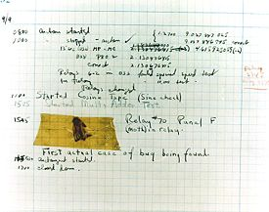

The First Bugs
Hopper’s “bug” (moth stuck in a relay on an early machine)
“an analyzing process must equally have been performed in order to furnish the Analytical Engine with the necessary operative data; and that herein may also lie a possible source of error. Granted that the actual mechanism is unerring in its processes, the cards may give it wrong orders. ” – Ada, Countess Lovelace (notes on Babbage’s Analytical Engine)
“It has been just so in all of my inventions. The first step is an intuition, and comes with a burst, then difficulties arise—this thing gives out and [it is] then that 'Bugs'—as such little faults and difficulties are called—show themselves and months of intense watching, study and labor are requisite. . .” – Thomas Edison

Slide 5
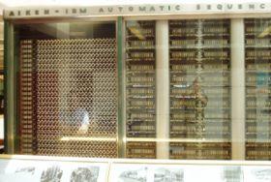

What is a computer bug?
In 1947 Harvard University was operating a room-sized computer called the Mark II.
mechanical relays
glowing vacuum tubes
technicians program the computer by reconfiguring it
Technicians had to change the occasional vacuum tube.
A moth flew into the computer and was zapped by the high voltage when it landed on a relay.
Hence, the first computer bug!
I am not making this up :-)

Slide 6
Bugs a.k.a. …
Defect
Fault
Problem
Error
Incident
Anomaly
Variance
Failure
Inconsistency
Product Anomaly
Product Incidence
Feature :-)

Slide 7
Costly Software Failures
NIST report, “The Economic Impacts of Inadequate Infrastructure for Software Testing” (2002)
Inadequate software testing costs the US alone between $22 and $59 billion annually
Better approaches could cut this amount in half
Huge losses due to web application failures
Financial services : $6.5 million per hour (just in USA!)
Credit card sales applications : $2.4 million per hour (in USA)
In Dec 2006, amazon.com’s BOGO offer turned into a double discount
2007 : Symantec says that most security vulnerabilities are due to faulty software

Slide 8

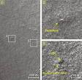
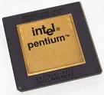
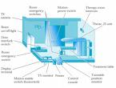
Spectacular Software Failures
NASA’s Mars lander: September 1999, crashed due to a units integration fault
Ariane 5: exception-handling bug : forced self destruct on maiden flight (64-bit to 16-bit conversion: about 370 million $ lost)
Mars Polar Lander crash site?
Toyota brakes : Dozens dead, thousands of crashes
Major failures: Ariane 5 explosion, Mars Polar Lander, Intel’s Pentium FDIV bug
Poor testing of safety-critical software can cost lives :
THERAC-25 radiation machine: 3 dead
THERAC-25 design
We need our software to be dependable
Testing is one way to assess dependability

Slide 9
Ariane 5 Rocket Goes Boom (1996)
Cost: $500 million
Disaster: Ariane 5, an unmanned rocket of the European Space Agency, was intentionally destroyed 37 seconds after launch on its maiden flight. Also destroyed was its cargo of four scientific satellites to study how the Earth’s magnetic field interacts with solar winds.
Cause: Shutdown occurred when the guidance computer tried to convert the sideways rocket velocity from 64b floating point to a 16b signed integer format. The number was too big, and an overflow error resulted. When the guidance system shut down, control passed to an identical redundant unit, which also failed because it was running the same algorithm.

Slide 10
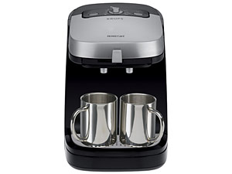


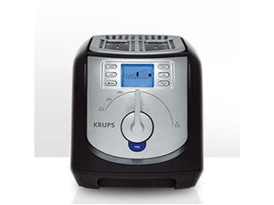

Software is a Skin that Surrounds Our Civilization
Quote due to Dr. Mark Harman

Slide 11
Pentium Fails Long Division (1993)
Cost: $475 million, corporate credibility
Disaster: Intel’s highly-promoted Pentium chip occasionally made mistakes when dividing floating-point numbers within a specific range. For example, dividing 4195835.0/3145727.0 yielded 1.33374 instead of 1.33382, an error of 0.006%. Although the bug affected few users, it become a public relations nightmare. With an estimated 5 million defective chips in circulation, Intel offered to replace Pentium chips only for consumers who could prove they needed high accuracy. Eventually Intel replaced the chips for anyone who complained.
Cause: The divider in the Pentium floating point unit had a flawed division table, missing about five of a thousand entries and resulting in these rounding errors.

Slide 12

Airbus 319 Safety Critical Software Control
Loss of autopilot
Loss of most flight deck lighting and intercom
Loss of both the commander’s and the co‑pilot’s primary flight and navigation displays !

Slide 13

Northeast Blackout of 2003
508 generating units and 256 power plants shut down
Affected 10 million people in Ontario, Canada
Affected 40 million people in 8 US states
Financial losses of
$6 Billion USD
The alarm system in the energy management system failed due to a software error and operators were not informed of the power overload in the system

Slide 14
What Does This Mean?
Software testing is getting more important

Slide 15
Testing in the 21st Century
More safety critical, real-time software
Embedded software is ubiquitous … check your pockets
Enterprise applications means bigger programs, more users
Paradoxically, free software increases our expectations !
Security is now all about software faults
Secure software is reliable software
The web offers a new deployment platform
Very competitive and very available to more users
Web apps are distributed
Web apps must be highly reliable
Industry desperately needs our inventions !

Slide 16
Cost of Testing
You’re going to spend at least half of your development budget on testing, whether you want to or not
In the real-world, testing is the principle post-design activity
Restricting early testing usually increases cost
Extensive hardware-software integration requires more testing

Slide 17
What is..........

Slide 18
Software Testing Definition
Software testing is a process,
to evaluate the functionality of a software application with an intent
to find whether the developed software met the specified requirements or not and
to identify the defects
to ensure that the product is defect-free in order to produce the quality product.

Slide 19
Test Design in Context
Test Design is the process of designing input values that will effectively test software
Test design is one of several activities for testing software
Most mathematical
Most technically challenging

Slide 20
Types of Test Activities
Testing can be broken up into four general types of activities
Test Design
Test Automation
Test Execution
Test Evaluation
Each type of activity requires different skills, background knowledge, education and training
No reasonable software development organization uses the same people for requirements, design, implementation, integration and configuration control
1.a) Criteria-based
1.b) Human-based

Slide 21
1. Test Design – (a) Criteria-Based
This is the most technical job in software testing
Requires knowledge of :
Discrete math
Programming
Testing
Requires much of a traditional CS degree
This is intellectually stimulating, rewarding, and challenging
Test design is analogous to software architecture on the development side
Using people who are not qualified to design tests is a sure way to get ineffective tests

Slide 22
1. Test Design – (b) Human-Based
This is much harder than it may seem to developers
Criteria-based approaches can be blind to special situations
Requires knowledge of :
Domain, testing, and user interfaces
Requires almost no traditional CS
A background in the domain of the software is essential
An empirical background is very helpful (biology, psychology, …)
A logic background is very helpful (law, philosophy, math, …)
This is intellectually stimulating, rewarding, and challenging
But not to typical CS majors – they want to solve problems and build things

Slide 23
2. Test Automation
This is slightly less technical
Requires knowledge of programming
Fairly straightforward programming – small pieces and simple algorithms
Requires very little theory
Very boring for test designers
Programming is out of reach for many domain experts
Who is responsible for determining and embedding the expected outputs ?
Test designers may not always know the expected outputs
Test evaluators need to get involved early to help with this

Slide 24
3. Test Execution
This is easy – and trivial if the tests are well automated
Requires basic computer skills
Interns
Employees with no technical background
Asking qualified test designers to execute tests is a sure way to convince them to look for a development job
If, for example, GUI tests are not well automated, this requires a lot of manual labor
Test executors have to be very careful and meticulous with bookkeeping

Slide 25
4. Test Evaluation
This is much harder than it may seem
Requires knowledge of :
Domain
Testing
User interfaces and psychology
Usually requires almost no traditional CS
A background in the domain of the software is essential
An empirical background is very helpful (biology, psychology, …)
A logic background is very helpful (law, philosophy, math, …)
This is intellectually stimulating, rewarding, and challenging
But not to typical CS majors – they want to solve problems and build things

Slide 26
Other Activities
Test management: Sets policy, organizes team, interfaces with development, chooses criteria, and decides how much automation is needed, …
Test maintenance: Save tests for reuse as software evolves
Requires cooperation of test designers and automators
Deciding when to trim the test suite is partly policy and partly technical – and in general, very hard !
Tests should be put in configuration control
Test documentation : All parties participate
Each test must document “why” – criterion and test requirement satisfied or a rationale for human-designed tests
Ensure traceability throughout the process
Keep documentation in the automated tests

Slide 27
Types of Test Activities – Summary
1a. | Design | Design test values to satisfy engineering goals
 | Criteria | Requires knowledge of discrete math, programming and testing
1b. | Design | Design test values from domain knowledge and intuition
 | Human | Requires knowledge of domain, UI, testing
2. | Automation | Embed test values into executable scripts
 |  | Requires knowledge of scripting
3. | Execution | Run tests on the software and record the results
 |  | Requires very little knowledge
4. | Evaluation | Evaluate results of testing, report to developers
 |  | Requires domain knowledge
These four general test activities are quite different
It is a poor use of resources to use people inappropriately

Slide 28
Organizing the Team
A mature test organization needs only one test designer to work with several test automators, executors and evaluators
Putting the wrong people on the wrong tasks leads to inefficiency, low job satisfaction and low job performance
A qualified test designer will be bored with other tasks and look for a job in development
A qualified test evaluator will not understand the benefits of test criteria
Test evaluators have the domain knowledge, so they must be free to add tests that “blind” engineering processes will not think of

Slide 29
Model-Driven Test Design
refined requirements / test specs
model / structure
test requirements
test requirements
DESIGN
ABSTRACTION
LEVEL
IMPLEMENTATION
ABSTRACTION
LEVEL
software artifact
input values
pass / fail
test results
test scripts
test cases

Slide 30
Model-Driven Test Design – Steps
criterion
refine
refined requirements / test specs
model / structure
test requirements
generate
analysis
test requirements
domain analysis
DESIGN
ABSTRACTION
LEVEL
IMPLEMENTATION
ABSTRACTION
LEVEL
software artifact
input values
feedback
evaluate
execute
automate
prefix
postfix
expected
pass / fail
test results
test scripts
test cases

Slide 31
Model-Driven Test Design – Activities
refined requirements / test specs
model / structure
test requirements
Test Design
DESIGN
ABSTRACTION
LEVEL
Raising our abstraction level makes
test design MUCH easier
IMPLEMENTATION
ABSTRACTION
LEVEL
software artifact
input values
Test Automation
pass / fail
test results
test scripts
test cases
Test Evaluation
Test Execution

Slide 32

Small Illustrative Example
Software Artifact : Java Method
/**
* Return index of node n at the
* first position it appears,
* -1 if it is not present
*/
public int indexOf (Node n)
{
for (int i=0; i < path.size(); i++)
if (path.get(i).equals(n))
return i;
return -1;
}
Control Flow Graph
1
i = 0
2
i < path.size()
3
if
5
4
return -1
return i

Slide 33

Example (2)
Graph
Abstract version
Edges
1 2
2 3
3 2
3 4
2 5
Initial Node: 1
Final Nodes: 4, 5
6 requirements for Edge-Pair Coverage 1. [1, 2, 3] 2. [1, 2, 5] 3. [2, 3, 4] 4. [2, 3, 2] 5. [3, 2, 3] 6. [3, 2, 5]
1
2
3
Test Paths
[1, 2, 5]
[1, 2, 3, 2, 5]
[1, 2, 3, 2, 3, 4]
5
4
Find values …

Slide 34
Goal of a software tester
… to find bugs
… as early in the software development processes as possible
… and make sure they get fixed.

Slide 35
How to define Software Testing Principles
Testing
The execution of a program to find its faults
Verification
The process of proving the programs correctness.
Validation
The process of finding errors by executing the program in a real environment
Debugging
Diagnosing the error and correct it
Notes:
Software testing is defined as the execution of a program to find its faults. While more time typically is spent on testing than in any other phase of software development, there is considerable confusion about its purpose. Many software professionals, for example, believe that tests are run to show that the program works rather than to learn about its faults.
Myers has provided some useful testing definitions:
Testing
The process of executing a program (or part of a program) with the intention of finding errors.
Verification
An attempt to find errors by executing a program in a test or simulated environment (it is now preferable to view verification as the process of proving the program’s correctness)
Validation
An attempt to find errors by executing a program in a real environment.
Debugging
Diagnosing the precise nature of a known error and then correcting it (debugging is a correction and not a testing activity)
Verification and validation are sometimes confused. They are, in fact, different activities. The difference between them is succinctly summarized by Boehm:
‘Validation: Are we building the right product?’
‘Verification: Are we building the product right?’

Slide 36
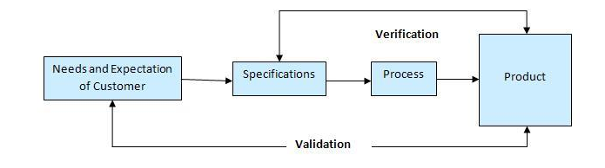
Fundamentals of Software Testing
Validation ??????
Verification ?????

Slide 37
Validation & Verification (IEEE)
Validation: The process of evaluating software at the end of software development to ensure compliance with intended usage
Verification: The process of determining whether the products of a given phase of the software development process fulfill the requirements established during the previous phase

Slide 38
Verification & Validation-Example
Lets say we are writing a program for addition.
a+b = c
Verification: “Are we building the product right?”
Are we getting some output for a+b? 1+1 = 6
Validation: “Are we building the right product?”
Are we getting correct output for a+b? 1+1=2

Slide 39
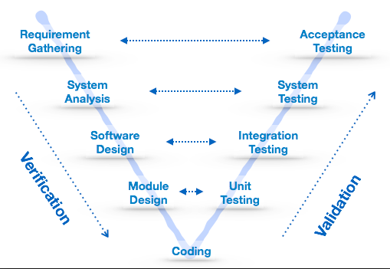
Fundamentals of Software Testing
Notes:
Verification and validation can be carried out during the development of the software work products. Software work products can be business scenarios or use cases, requirements specifications, design documents and code

Slide 40
Validation Vs Verification
 | Verification | Validation
1 | Involves comparing a work product with process, standards and guidelines. | Involves checking the outcome of developed product and process used with respect to standards and expectations of a customer.
2 | Are we building the product right? | Are we building the right product?
3 | Ensures that the software system meets all functionalities. | Ensures that the functionalities meets the users needs and requirements
4 | Done by Developers | Done by Testers

Slide 41
Validation Vs Verification
 | Verification | Validation
5 | Verification uses methods like inspections, reviews, walkthroughs, etc. | Validation uses methods like black box (functional) testing, gray box testing, and white box (structural) testing etc.
6 | It generally comes first-done before validation. | It generally follows after verification.(Testing & validating actual product)
7 | It is human based checking of documents and files. | It is computer based execution of program.
8 | It does not involve executing the code | It always involves executing the code

Slide 42
Test Engineer & Test Managers
Test Engineer: An IT professional who is in charge of one or more technical test activities
designing test inputs
producing test values
running test scripts
analyzing results
reporting results to developers and managers
Test Manager: In charge of one or more test engineers
sets test policies and processes
interacts with other managers on the project
otherwise helps the engineers do their work

Slide 43
Static and Dynamic Testing
Static Testing: Testing without executing the program.
This includes software inspections and some forms of analyses
Very effective at finding certain kinds of problems – especially “potential” faults, that is, problems that could lead to faults when the program is modified
Dynamic Testing : Testing by executing the program with real inputs

Slide 44
Software Faults, Errors & Failures
Software Fault: A static defect in the software
Software Failure: External, incorrect behavior with respect to the requirements or other description of the expected behavior
Software Error: An incorrect internal state that is the manifestation of some fault

Slide 45
Testing & Debugging
Testing: Finding inputs that cause the software to fail
Debugging: The process of finding a fault given a failure

Slide 46
Fault & Failure Model
Three conditions necessary for a failure to be observed
Reachability : The location or locations in the program that contain the fault must be reached
Infection : The state of the program must be incorrect
Propagation : The infected state must propagate to cause some output of the program to be incorrect

Slide 47
Test Case
Test Case Values: The values that directly satisfy one test requirement
Expected Results: The result that will be produced when executing the test if the program satisfies it intended behavior

Slide 48
Testing Goals Based on Test Process Maturity
Level 0 : There’s no difference between testing and debugging
Level 1 : The purpose of testing is to show correctness
Level 2 : The purpose of testing is to show that the software doesn’t work
Level 3 : The purpose of testing is not to prove anything specific, but to reduce the risk of using the software
Level 4 : Testing is a mental discipline that helps all IT professionals develop higher quality software

Slide 49
Level 0 Thinking
Testing is the same as debugging
Does not distinguish between incorrect behavior and mistakes in the program
Does not help develop software that is reliable or safe
This is what we teach undergraduate CS majors

Slide 50
Level 1 Thinking
Purpose is to show correctness
Correctness is impossible to achieve
What do we know if no failures?
Good software or bad tests?
Test engineers have no:
Strict goal
Real stopping rule
Formal test technique
Test managers are powerless
This is what hardware engineers often expect

Slide 51
Level 2 Thinking
Purpose is to show failures
Looking for failures is a negative activity
Puts testers and developers into an adversarial relationship
What if there are no failures?
This describes most software companies.
How can we move to a team approach ??

Slide 52
Level 3 Thinking
Testing can only show the presence of failures
Whenever we use software, we incur some risk
Risk may be small and consequences unimportant
Risk may be great and consequences catastrophic
Testers and developers cooperate to reduce risk
This describes a few “enlightened” software companies

Slide 53
Level 4 Thinking
A mental discipline that increases quality
Testing is only one way to increase quality
Test engineers can become technical leaders of the project
Primary responsibility to measure and improve software quality
Their expertise should help the developers
This is the way “traditional” engineering works

Slide 54
Where Are You?
Are you at level 0, 1, or 2 ?
Is your organization at work at level 0, 1, or 2 ?
Or 3?
We hope to teach you to become “change agents” in your workplace …
Advocates for level 4 thinking

Slide 55
How to Improve Testing ?
Testers need more and better software tools
Testers need to adopt practices and techniques that lead to more efficient and effective testing
More education
Different management organizational strategies
Testing / QA teams need more technical expertise
Developer expertise has been increasing dramatically
Testing / QA teams need to specialize more
This same trend happened for development in the 1990s

Slide 56
Software Testing Foundations
Testing can only show the presence of failures
Not their absence

Slide 57
Testing & Debugging
Testing : Evaluating software by observing its execution
Test Failure : Execution of a test that results in a software failure
Debugging : The process of finding a fault given a failure
Not all inputs will “trigger” a fault into causing a failure

Slide 58
Fault & Failure Model (RIPR)
Four conditions necessary for a failure to be observed
Reachability: The location or locations in the program that contains the fault must be reached
Infection: The state of the program must be incorrect
Propagation: The infected state must cause some output or final state of the program to be incorrect
Reveal: The tester must observe part of the incorrect portion of the program state

Slide 59
RIPR Model
Reachability
Infection
Propagation
Revealability
Test
Final Program State
Observed Final Program State
Reaches
Observed Final Program State
Fault
Incorrect Final State
Infects
Incorrect Program State
Propagates
Reveals
Test Oracles
Notes:
The failures can be revealed when the observed final program state has overlap with the incorrect final program state.
The question is: should testers check the entire program state? How to observe the incorrect program state in a cost-effective manner.
Getting the overlap as big as possible and use the cost as small as possible.

Slide 60
Traditional Testing Levels
Acceptance testing : Is the software acceptable to the user?
main Class P
System testing : Test the overall functionality of the system
Class A
Class B
Integration testing : Test how modules interact with each other
method mA1()
method mB1()
method mA2()
method mB2()
Module testing (developer testing) : Test each class, file, module, component
This view obscures underlying similarities
Unit testing (developer testing) : Test each unit (method) individually

Slide 61
Object-Oriented Testing Levels
Inter-class testing : Test multiple classes together
Class A
Class B
Intra-class testing : Test an entire class as sequences of calls
method mA1()
method mB1()
method mA2()
method mB2()
Inter-method testing : Test pairs of methods in the same class
Intra-method testing : Test each method individually

Slide 62
New : Test Coverage Criteria
A tester’s job is simple :
Define a model of the software, then find ways to cover it
Test Requirements: A specific element of a software artifact that a test case must satisfy or cover
Coverage Criterion: A rule or collection of rules that impose test requirements on a test set
Testing researchers have defined dozens of criteria, but they are all really just a few criteria on four types of structures …

Slide 63
Coverage Criteria
Even small programs have too many inputs to fully test them all
private static double computeAverage (int A, int B, int C)
On a 32-bit machine, each variable has over 4 billion possible values
Over 80 octillion possible tests!!
Input space might as well be infinite
Testers search a huge input space
Trying to find the fewest inputs that will find the most problems
Coverage criteria give structured, practical ways to search the input space
Search the input space thoroughly
Not much overlap in the tests

Slide 64
Advantages of Coverage Criteria
Maximize the “bang for the buck”
Provide traceability from software artifacts to tests
Source, requirements, design models, …
Make regression testing easier
Gives testers a “stopping rule” … when testing is finished
Can be well supported with powerful tools

Slide 65
Test Requirements and Criteria
Test Criterion : A collection of rules and a process that define test requirements
Cover every statement
Cover every functional requirement
Test Requirements : Specific things that must be satisfied or covered during testing
Each statement might be a test requirement
Each functional requirement might be a test requirement
Testing researchers have defined dozens of criteria, but they are all really just a few criteria on four types of structures …
Input domains
Graphs
Logic expressions
Syntax descriptions

Slide 66
Source of Structures
These structures can be extracted from lots of software artifacts
Graphs can be extracted from UML use cases, finite state machines, source code, …
Logical expressions can be extracted from decisions in program source, guards on transitions, conditionals in use cases, …
This is not the same as “model-based testing,” which derives tests from a model that describes some aspects of the system under test
The model usually describes part of the behavior
The source is explicitly not considered a model

Slide 67
Criteria Based on Structures
Structures : Four ways to model software
Input Domain Characterization (sets)
A: {0, 1, >1}
B: {600, 700, 800}
C: {swe, cs, isa, infs}
Graphs
Logical Expressions
(not X or not Y) and A and B
if (x > y)
z = x - y;
else
z = 2 * x;
Syntactic Structures (grammars)

Slide 68

Example : Jelly Bean Coverage
Flavors :
Lemon
Pistachio
Cantaloupe
Pear
Tangerine
Apricot
Colors :
Yellow (Lemon, Apricot)
Green (Pistachio)
Orange (Cantaloupe, Tangerine)
White (Pear)
Possible coverage criteria :
Taste one jelly bean of each flavor
Deciding if yellow jelly bean is Lemon or Apricot is a controllability problem
Taste one jelly bean of each color

Slide 69
Coverage
Given a set of test requirements TR for coverage criterion C, a test set T satisfies C coverage if and only if for every test requirement tr in TR, there is at least one test t in T such that t satisfies tr
Infeasible test requirements : test requirements that cannot be satisfied
No test case values exist that meet the test requirements
Example: Dead code
Detection of infeasible test requirements is formally undecidable for most test criteria
Thus, 100% coverage is impossible in practice

Slide 70
More Jelly Beans
T1 = { three Lemons, one Pistachio, two Cantaloupes, one Pear, one Tangerine, four Apricots }
Does test set T1 satisfy the flavor criterion ?
T2 = { One Lemon, two Pistachios, one Pear, three Tangerines }
Does test set T2 satisfy the flavor criterion ?
Does test set T2 satisfy the color criterion ?

Slide 71
Types of Testing
Levels of testing include different methodologies that can be used while conducting software testing.
The main levels of software testing are −
Functional Testing
Non-functional Testing

Slide 72
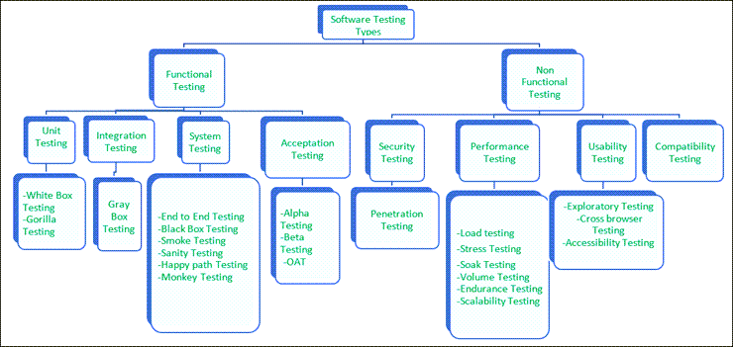

Slide 73
Functional Testing
This is a type of black-box testing that is based on the specifications of the software that is to be tested.
The application is tested by providing input and then the results are examined that need to confirm to the functionality it was intended for.
Functional testing of a software is conducted on a complete, integrated system to evaluate the system's compliance with its specified requirements.
There are four main types of functional testing.

Slide 74
There are five steps that are involved while testing an application for functionality.
I | The determination of the functionality that the intended application is meant to perform.
II | The creation of test data based on the specifications of the application.
III | The output based on the test data and the specifications of the application.
IV | The writing of test scenarios and the execution of test cases.
V | The comparison of actual and expected results based on the executed test cases.

Slide 75
1.Unit Testing
Unit testing is a type of software testing which is done on an individual unit or component to test its corrections.
Typically, Unit testing is done by the developer at the application development phase.
Each unit in unit testing can be viewed as a method, function, procedure, or object.
Developers often use test automation tools such as NUnit, Xunit, JUnit for the test execution.
Unit testing is important because we can find more defects at the unit test level.
For example, there is a simple calculator application. The developer can write the unit test to check if the user can enter two numbers and get the correct sum for addition functionality.

Slide 76
1.Unit Testing
a) White Box Testing
White box testing is a test technique in which the internal structure or code of an application is visible and accessible to the tester.
In this technique, it is easy to find loopholes in the design of an application or fault in business logic.
Statement coverage and decision coverage/branch coverage are examples of white box test techniques.
b) Gorilla Testing
Gorilla testing is a test technique in which the tester and/or developer test the module of the application thoroughly in all aspects.
Gorilla testing is done to check how robust your application is.

Slide 77
Unit Testing (White Box)
Individual components are tested.
It is a path test.
To focus on a relatively small segment of code and aim to exercise a high percentage of the internal path
Disadvantage: the tester may be biased by previous experience. And the test value may not cover all possible values.
Notes:
When unit tests are done on a white box basis, they are essentially path test. The idea is to focus on a relatively small segment of code and aim to exercise a high percentage of the internal paths. The simplest approach is to ensure that every statement is exercised at least once. A more stringent criterion is to require coverage of every path within a program.
One disadvantage of white box testing is that the tester may be biased by previous experience. The tests are often designed by the programmers who produced the code since they may be the only ones who understand it. Unfortunately, those who created the programs’ faults are least likely to recognize them. Even though all the paths and variable of the program have gone through by the testing program, it could not guarantee all possible values of the variables have been tested.
While its disadvantages are significant, white box testing generally has the highest error yield of all testing techniques.

Slide 78
2) Integration Testing
Integration testing is a type of software testing where two or more modules of an application are logically grouped together and tested as a whole.
The focus of this type of testing is to find the defect on interface, communication, and data flow among modules.
Top-down or Bottom-up approach is used while integrating modules into the whole system.
This type of testing is done on integrating modules of a system or between systems.
For example, a user is buying a flight ticket from any airline website. Users can see flight details and payment information while buying a ticket, but flight details and payment processing are two different systems. Integration testing should be done while integrating of airline website and payment processing system.

Slide 79
Integration Testing
Top-down Integration Test
Bottom-up Integration Test
Notes:
This phase involves testing of modules which have been integrated in sub-system. A module is a collection of dependent components such as object class, and abstract data type of some looser collection of procedures and functions.
On very large system it is often wise to do integration testing in several steps. Such systems generally have several relatively large components that can be built and integrated separately before combination into a full system.
Integration Testing is divided into Top-down Integration Test and Bottom-up Integration Test.

Slide 80
Top-down Integration Test
The control program is tested first. Modules are integrated one at a time. Emphasize on interface testing
Advantages: No test drivers needed
Interface errors are discovered early
Modular features aid debugging
Disadvantages: Test stubs are needed
Errors in critical modules at low levels are found late.
Notes:
Top-down Integration Test starts with the most abstract components and works downwards.
It tests the high levels of a system before testing its detailed components. The program is represented as a single abstract component with sub-components represented by stubs.
Top-down Integration Test is essentially a prototyping philosophy. The initial tests establish a basic system skeleton from the top and each new module adds capability. The problem is that functions of the lower-level modules that are not initially present must by simulated by program stubs. While producing such stubs may at first seem easy, it would be more difficult as more stub add on it. It may be difficult or impossible to test certain logical conditions such as error handling.

Slide 81
Bottom-up Integration Test
Allow early testing aimed at proving feasibility
Emphasize on module functionality and performance
Advantages: No test stubs are needed
Errors in critical modules are found early
Disadvantages: Test drivers are needed
Interface errors are discovered late

Slide 82
Bottom-up testing
Test
Drivers
Test
Drivers
Test
Drivers
Level N
Level N
Level N
Test
Drivers
Test
Drivers
Level N-1
Level N-1
Notes:
Bottom-up testing is the converse of top-down testing. It involves testing the modules at the lower levels in the hierarchy, and then working up the hierarchy of modules until the final module is tested.

Slide 83
3) System Testing
System testing is type of testing where the tester evaluates the whole system against the specified requirements.
a) End to End Testing
It involves testing a complete application environment in a situation that mimics real-world use, such as interacting with a database, using network communications, or interacting with other hardware, applications, or systems if appropriate.
For example, a tester is testing a pet insurance website. End to End testing involves testing buying an insurance policy, LPM, tag, adding another pet, updating credit card information on users’ accounts, updating user address information, and receiving order confirmation emails and policy documents.
b) Black Box Testing
Blackbox testing is a software testing technique in which testing is performed without knowing the internal structure, design, or code of a system under test. Testers should focus only on the input and output of test objects.

Slide 84
3) System Testing
c) Smoke Testing
Smoke testing is performed to verify that basic and critical functionality of the system under test is working fine at a very high level.
Whenever a new build is provided by the development team, then the Software Testing team validates the build and ensures that no major issue exists. The testing team will ensure that the build is stable, and a detailed level of testing will be carried out further.
d) Sanity Testing
Sanity testing is performed on a system to verify that newly added functionality or bug fixes are working fine. Sanity testing is done on stable build. It is a subset of the regression test.
For example, a tester is testing a pet insurance website. There is a change in the discount for buying a policy for second pet. Then sanity testing is only performed on buying insurance policy module.

Slide 85
4) Acceptance Testing
Acceptance testing is a type of testing where client/business/customer test the software with real-time business scenarios.
The client accepts the software only when all the features and functionalities work as expected. This is the last phase of testing, after which the software goes into production. This is also called User Acceptance Testing (UAT).
a) Alpha Testing
Alpha testing is a type of acceptance testing performed by the team in an organization to find as many defects as possible before releasing software to customers.
For example, the pet insurance website is under UAT. UAT team will run real-time scenarios like buying an insurance policy, buying annual membership, changing the address, and ownership transfer of the pet in a same way the user uses the real website. The team can use test credit card information to process payment-related scenarios.

Slide 86
b) Beta Testing
Beta Testing is a type of software testing which is carried out by the clients/customers. It is performed in the Real Environment before releasing the product to the market for the actual end-users.
Beta Testing is carried out to ensure that there are no major failures in the software or product, and it satisfies the business requirements from an end-user perspective. Beta Testing is successful when the customer accepts the software.

Slide 87
c) Operational acceptance testing (OAT)
Operational acceptance testing of the system is performed by operations or system administration staff in the production environment. The purpose of operational acceptance testing is to make sure that the system administrators can keep the system working properly for the users in a real-time environment.
The focus of the OAT is on the following points:
Testing of backup and restore.
Installing, uninstalling, upgrading software.
The recovery process in case of natural disaster.
User management.
Maintenance of the software.

Slide 88
Non-Functional Testing
1) Security Testing
It is a type of testing performed by a special team. Any hacking method can penetrate the system.
Security Testing is done to check how the software, application, or website is secure from internal and/or external threats. This testing includes how much software is secure from malicious programs, viruses and how secure & strong the authorization and authentication processes are.
It also checks how software behaves for any hacker’s attack & malicious programs and how software is maintained for data security after such a hacker attack.

Slide 89
a) Penetration Testing
Penetration Testing or Pen testing is the type of security testing performed as an authorized cyberattack on the system to find out the weak points of the system in terms of security.
Pen testing is performed by outside contractors, generally known as ethical hackers. That is why it is also known as ethical hacking. Contractors perform different operations like SQL injection, URL manipulation, Privilege Elevation, session expiry, and provide reports to the organization.

Slide 90
2) Performance Testing
Performance testing is testing of an application’s stability and response time by applying load.
The word stability means the ability of the application to withstand in the presence of load. Response time is how quickly an application is available to users. Performance testing is done with the help of tools. Loader.IO, JMeter, LoadRunner, etc. are good tools available in the market.
a) Load testing
Load testing is testing of an application’s stability and response time by applying load, which is equal to or less than the designed number of users for an application.
For example, your application handles 100 users at a time with a response time of 3 seconds, then load testing can be done by applying a load of the maximum of 100 or less than 100 users. The goal is to verify that the application is responding within 3 seconds for all the users.

Slide 91
b) Stress Testing
Stress testing is testing an application’s stability and response time by applying load, which is more than the designed number of users for an application.
For example, your application handles 1000 users at a time with a response time of 4 seconds, then stress testing can be done by applying a load of more than 1000 users. Test the application with 1100,1200,1300 users and notice the response time. The goal is to verify the stability of an application under stress.

Slide 92
C) Scalability Testing
Scalability testing is testing an application’s stability and response time by applying load, which is more than the designed number of users for an application.
For example, your application handles 1000 users at a time with a response time of 2 seconds, then scalability testing can be done by applying a load of more than 1000 users and gradually increasing the number of users to find out where exactly my application is crashing.
Let’s say my application is giving response time as follows:
1000 users -2 sec
1400 users -2 sec
4000 users -3 sec
5000 users -45 sec
5150 users- crash – This is the point that needs to identify in scalability testing

Slide 93
d) Volume testing (flood testing)
Volume testing is testing an application’s stability and response time by transferring a large volume of data to the database. Basically, it tests the capacity of the database to handle the data.
e) Endurance Testing (Soak Testing)
Endurance testing is testing an application’s stability and response time by applying load continuously for a longer period to verify that the application is working fine.
For example, car companies soak testing to verify that users can drive cars continuously for hours without any problem.

Slide 94
3) Usability Testing
Usability testing is testing an application from the user’s perspective to check the look and feel and user-friendliness.
For example, there is a mobile app for stock trading, and a tester is performing usability testing.
Testers can check the scenario like if the mobile app is easy to operate with one hand or not, scroll bar should be vertical, background color of the app should be black and price of and stock is displayed in red or green color.
The main idea of usability testing of this kind of app is that as soon as the user opens the app, the user should get a glance at the market.

Slide 95
a) Exploratory testing
Exploratory Testing is informal testing performed by the testing team. The objective of this testing is to explore the application and look for defects that exist in the application. Testers use the knowledge of the business domain to test the application. Test charters are used to guide the exploratory testing.
b) Cross browser testing
Cross browser testing is testing an application on different browsers, operating systems, mobile devices to see look and feel and performance.

Slide 96
c) Accessibility Testing
The aim of Accessibility Testing is to determine whether the software or application is accessible for disabled people or not.
Here, disability means deafness, color blindness, mentally disabled, blind, old age, and other disabled groups. Various

Slide 97
Black-Box Testing
The technique of testing without having any knowledge of the interior workings of the application is called black-box testing.
The tester is oblivious to the system architecture and does not have access to the source code.
Typically, while performing a black-box test, a tester will interact with the system's user interface by providing inputs and examining outputs without knowing how and where the inputs are worked upon.
Black box testing can be applied to three main types of tests: functional, non-functional, and regression testing.

Slide 98
Regression Testing
Regression testing is testing of unchanged features of the application to make sure that any bug fixes, adding new features, deleting, or updating existing features, are not impacting the working application.
To find out regression scope is an important part of Regression Testing.
To find out the regression scope, the Tester needs to find out the area of application where changes happened and the Impact of those changes on the entire application.
It is difficult to cover the whole regression test suite in every release, so Automation Testing Tools are used in regression testing.

Slide 99
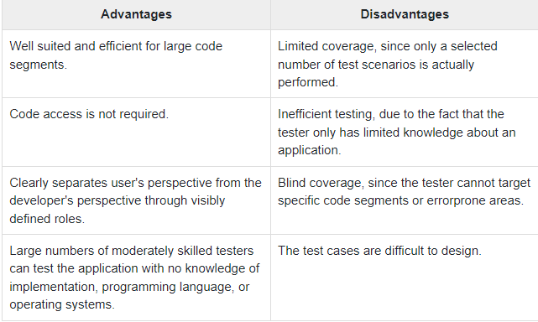

Slide 100
White-Box Testing
White-box testing is the detailed investigation of internal logic and structure of the code.
White-box testing is also called glass testing or open-box testing.
In order to perform white-box testing on an application, a tester needs to know the internal workings of the code.
The tester needs to have a look inside the source code and find out which unit/chunk of the code is behaving inappropriately.

Slide 101
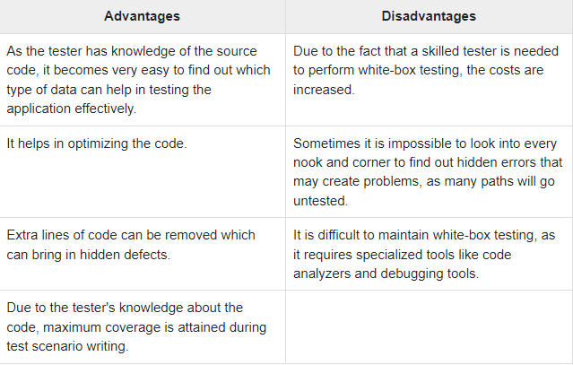

Slide 102
Grey-Box Testing
Grey-box testing is a technique to test the application with having a limited knowledge of the internal workings of an application.
In software testing, the phrase the more you know, the better carries a lot of weight while testing an application.
Mastering the domain of a system always gives the tester an edge over someone with limited domain knowledge.
Unlike black-box testing, where the tester only tests the application's user interface; in grey-box testing, the tester has access to design documents and the database.
Having this knowledge, a tester can prepare better test data and test scenarios while making a test plan.

Slide 103
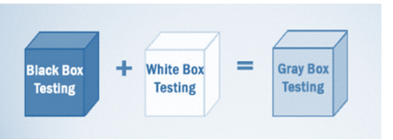
Gray Box Testing is a software testing method, which is a combination of both White Box Testing and Black Box Testing method.
In White Box testing internal structure (code) is known
In Black Box testing internal structure (code) is unknown
In Grey Box Testing internal structure (code) is partially known

Slide 104
Techniques used for Grey box Testing are-
Matrix Testing: This testing technique involves defining all the variables that exist in their programs.
Regression Testing: To check whether the change in the previous version has regressed other aspects of the program in the new version. It will be done by testing strategies like retest all, retest risky use cases, retest within a firewall.
Orthogonal Array Testing or OAT: It provides maximum code coverage with minimum test cases.
Pattern Testing: This testing is performed on the historical data of the previous system defects. Unlike black box testing, gray box testing digs within the code and determines why the failure happened

Slide 105
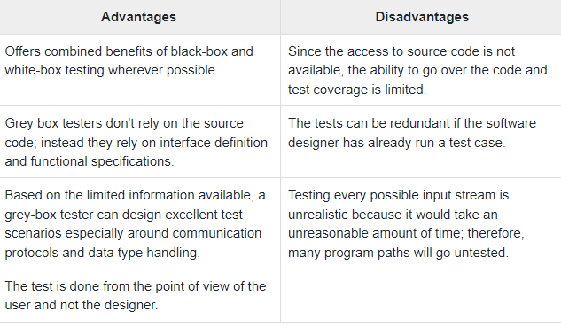

Slide 106
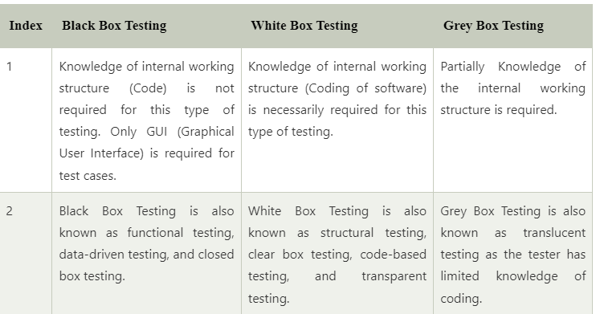
Black Box Testing vs. White Box Testing vs. Grey Box Testing

Slide 107
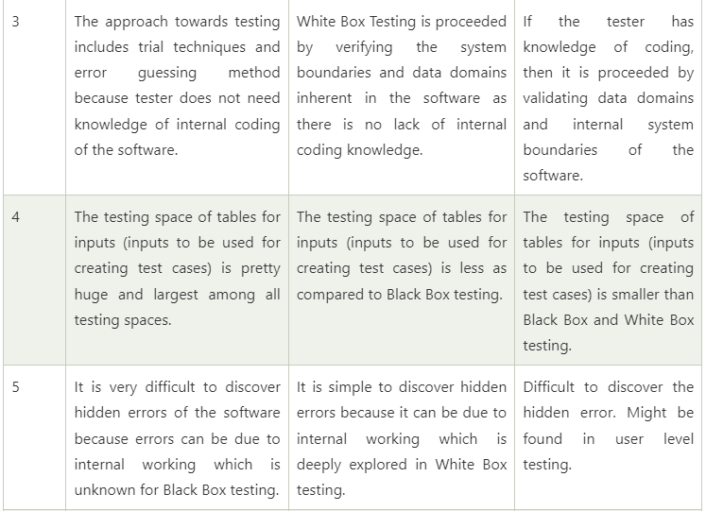

Slide 108
